Slide 1
2019 Dean’s List of Realtors

Slide 2
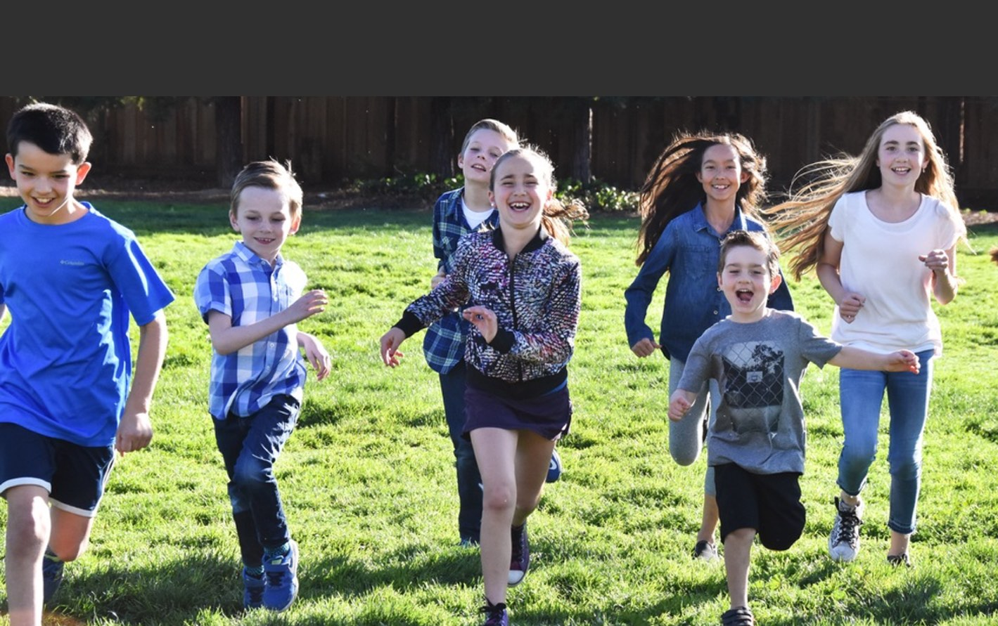
Los Gatos Education Foundation
Serving our youth for over 35 years
Supports five Los Gatos public schools
Funds supplemental teachers and staff in:
Math, Literacy, Health, Art, Music PE, Library, Counseling, and Middle School Electives

Slide 3
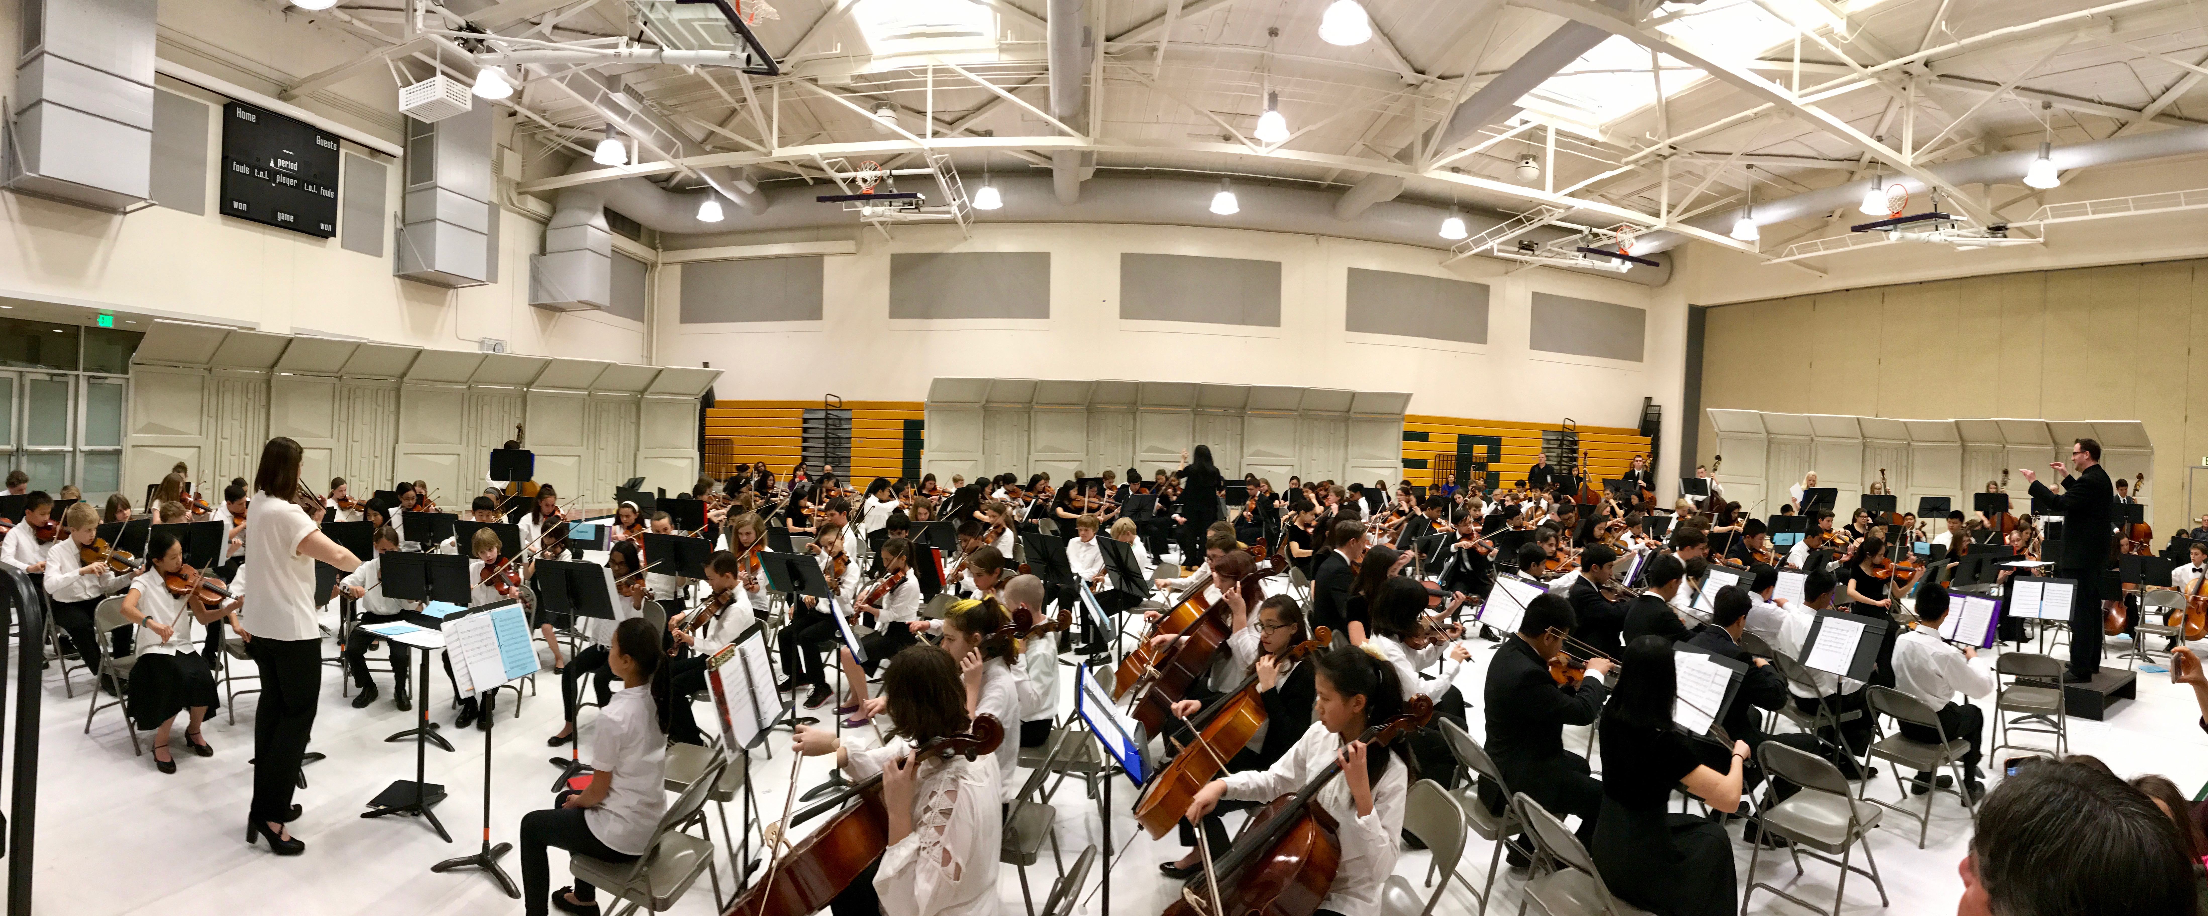
LGEF Reach
Reach 2,500 families and 3,250 students
Covers 95% of Los Gatos children in grades K-8
14% of families are new this year

Slide 4
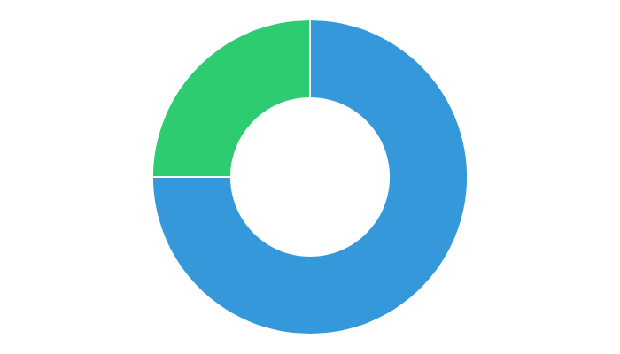
School Quality Drives Housing Prices
75%
of parents say their child’s education is an important part of the search for a new home
Source: Bank of America 2016 Homebuyer Insights Report
Los Gatos Union School District homes sell for
more than homes in neighboring districts

Slide 5
Many Bay Area communities have successful Real Estate programs
Los Altos
Palo Alto
Burlingame

Slide 6
Dean’s List of Realtors 2019
Support the Realtors who Support our Schools
SAMPLE
Leadership Circle - $5,000
Valedictorian - $2,500
Amanda Agent
RG Group
(408) 345-6789
Alice Agent
RG Group
(408) 345-6789
Andre Agent
RG Group
(408) 345-6789
Angela Agent
RG Group
(408) 345-6789
Sal Agent
RG Group
(408) 345-6789
Linda Agent
RG Group
(408) 345-6789
Salutatorian - $1,000
Alyssa Agent
RG Group
(408) 345-6789
James Agent
RG Group
(408) 345-6789
Amy Agent
RG Group
(408) 345-6789
Arnie Agent
RG Group
(408) 345-6789
Office Sponsors

Slide 7
LGEF Dean’s List Benefits Build your brand and reach clients…while you help our local schools
 | Leadership Circle $5,000 | Valedictorian $2,500 | Salutatorian $1,000 | Office Sponsor $5,000
Advertisement in Los Gatos Weekly (21,250 circulation) | ✓ | ✓ | ✓ | ✓
Advertisement in Los Gatos Magazine (15,000 Circulation) | ✓ | ✓ | ✓ | ✓
Logo on LGEF.Org | ✓ | ✓ | ✓ | ✓
LGEF President’s Email (4,000 parents) | ✓ | ✓ | ✓ | ✓
School eNewsletters (4,000 parents) | ✓ | ✓ | ✓ | ✓
Logo at Holiday Parade (over 10,000 people) | ✓ | ✓ |  | ✓
Featured in article on LGEF.Org (thousands of visitors per year) | ✓ |  |  | ✓
Special LGEF Facebook Post (average 1,000 readers/post) | ✓ | ✓
Your Own Custom Member Graphic Use to promote your membership | ✓ | ✓ | ✓ | ✓
Leadership Circle Events (LGEF donors $5000+) | ✓ |  |  | ✓

Slide 8
Advertising
circulation: 21, 250
circulation: 15,000

Slide 9
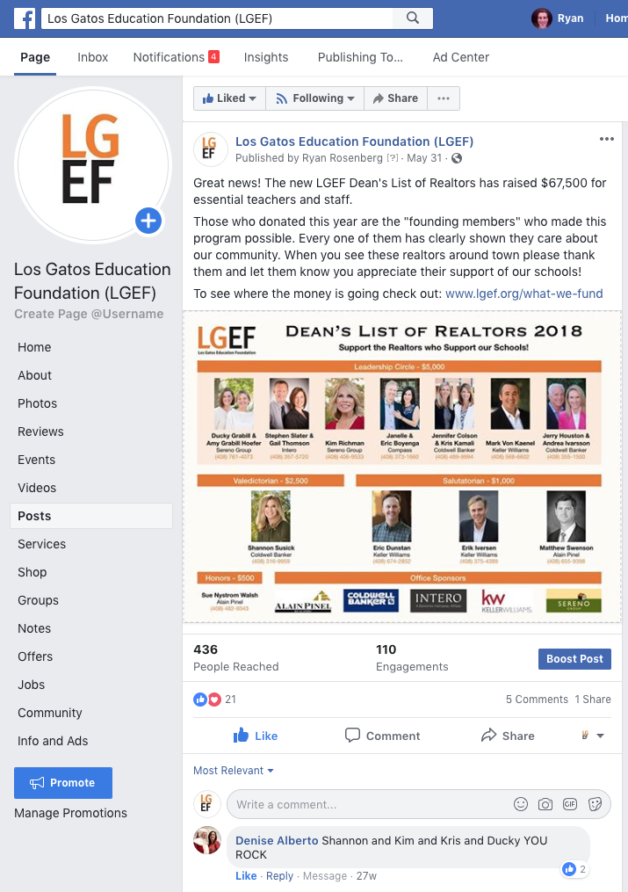
Online
LGEF Web Site
www.lgef.org
LGEF President’s eMail
Circulation: 4,000 parents
50% open rate
LGEF Facebook Page
Circulation: 1,000 reaches/post

Slide 10
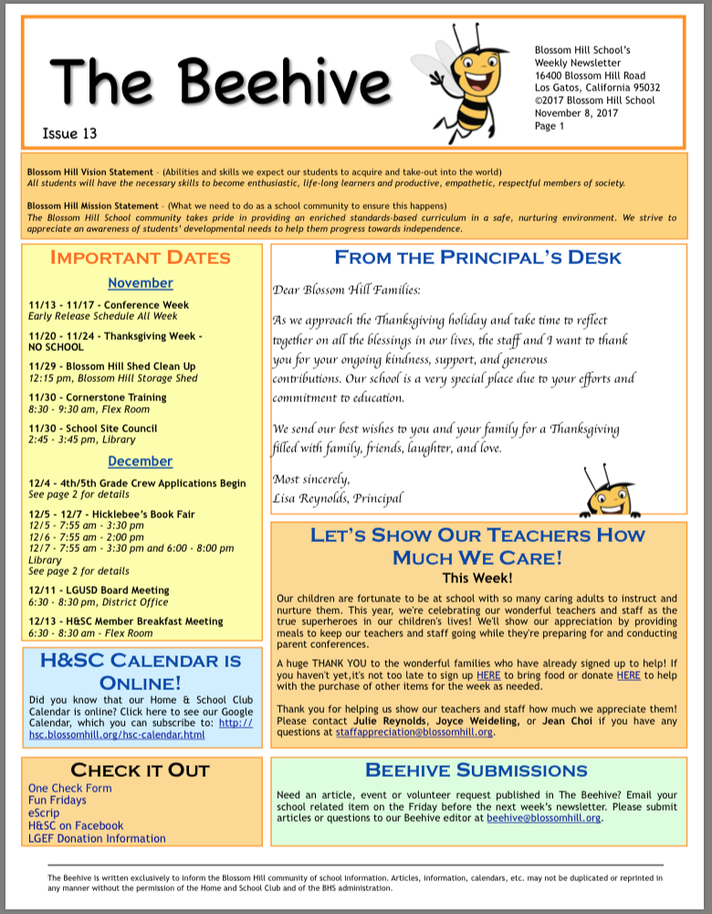
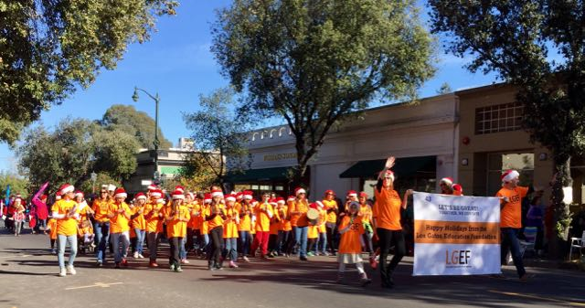
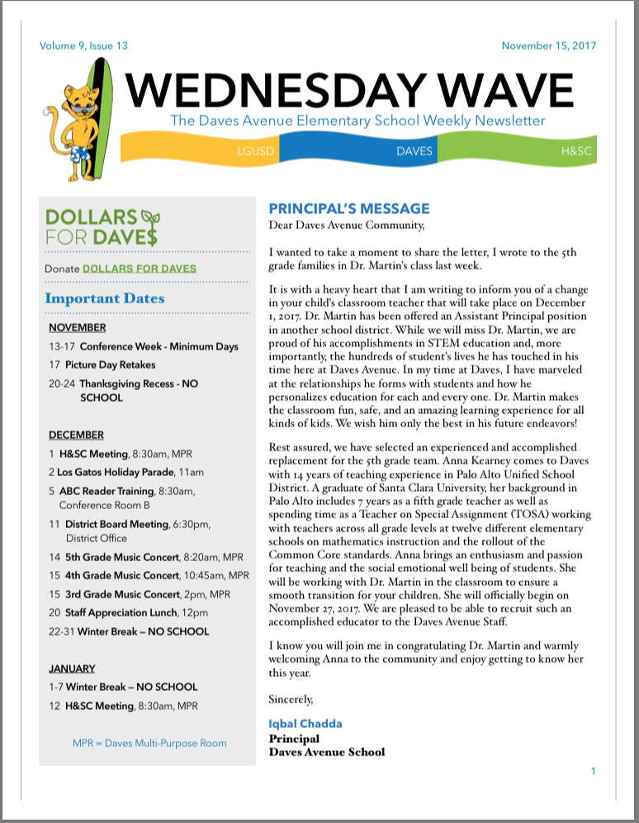
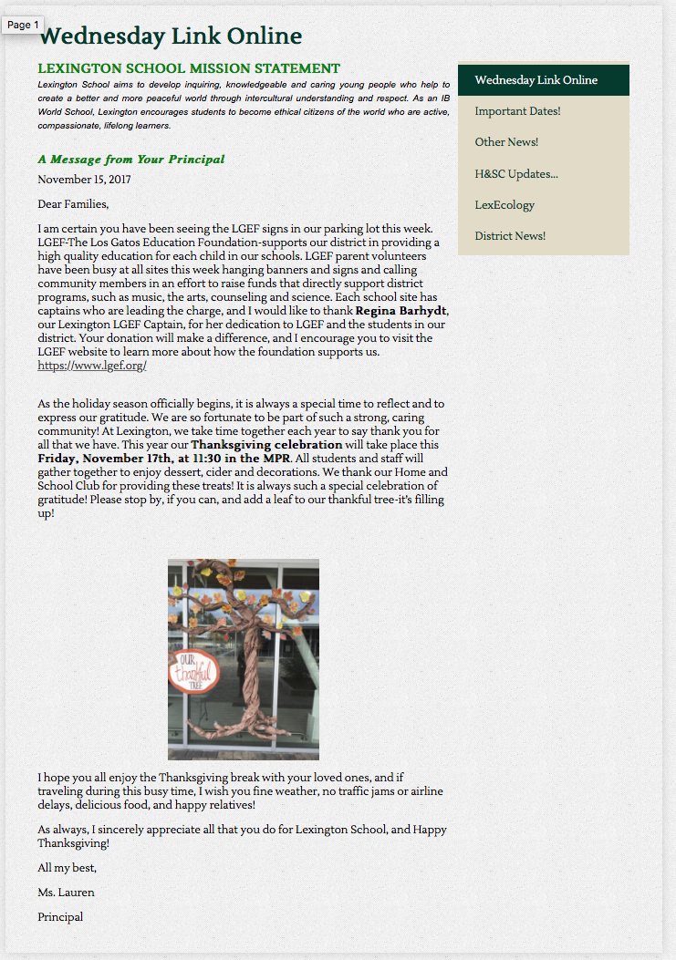
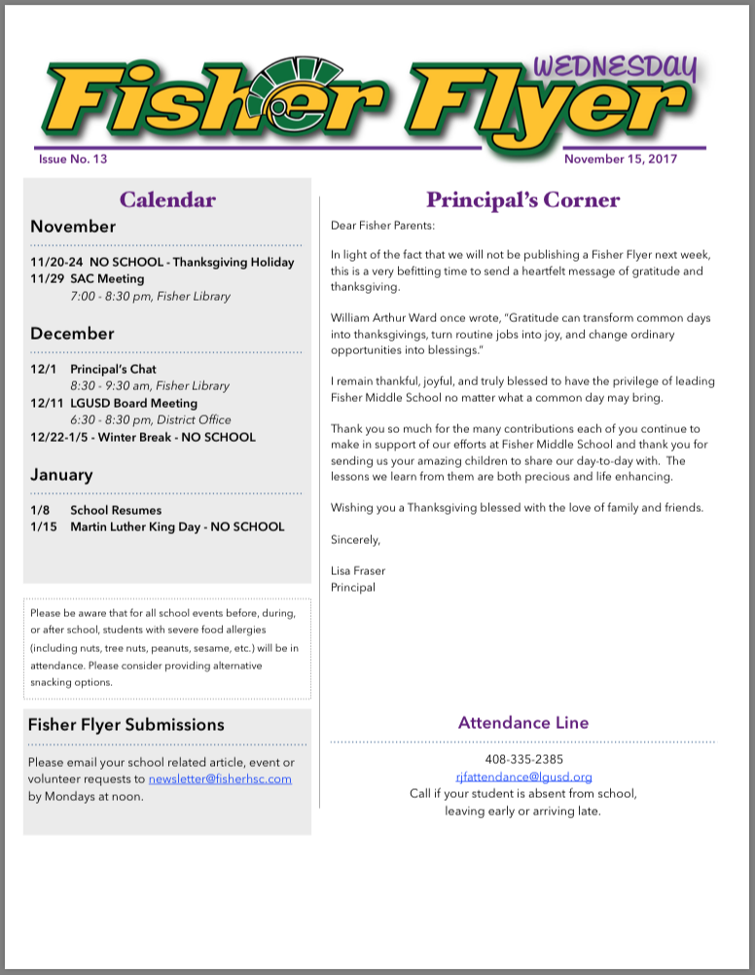
More…
Announcement in
School Newsletters
Circulation: 4,000 parents
Logo with LGEF at Holiday Parade
Circulation: over 10,000
Your Own Custom Graphic
Show your support of our schools!

Slide 11
LGEF Business Sponsors
Los Gatos parents are loyal to businesses who support our schools

Slide 12
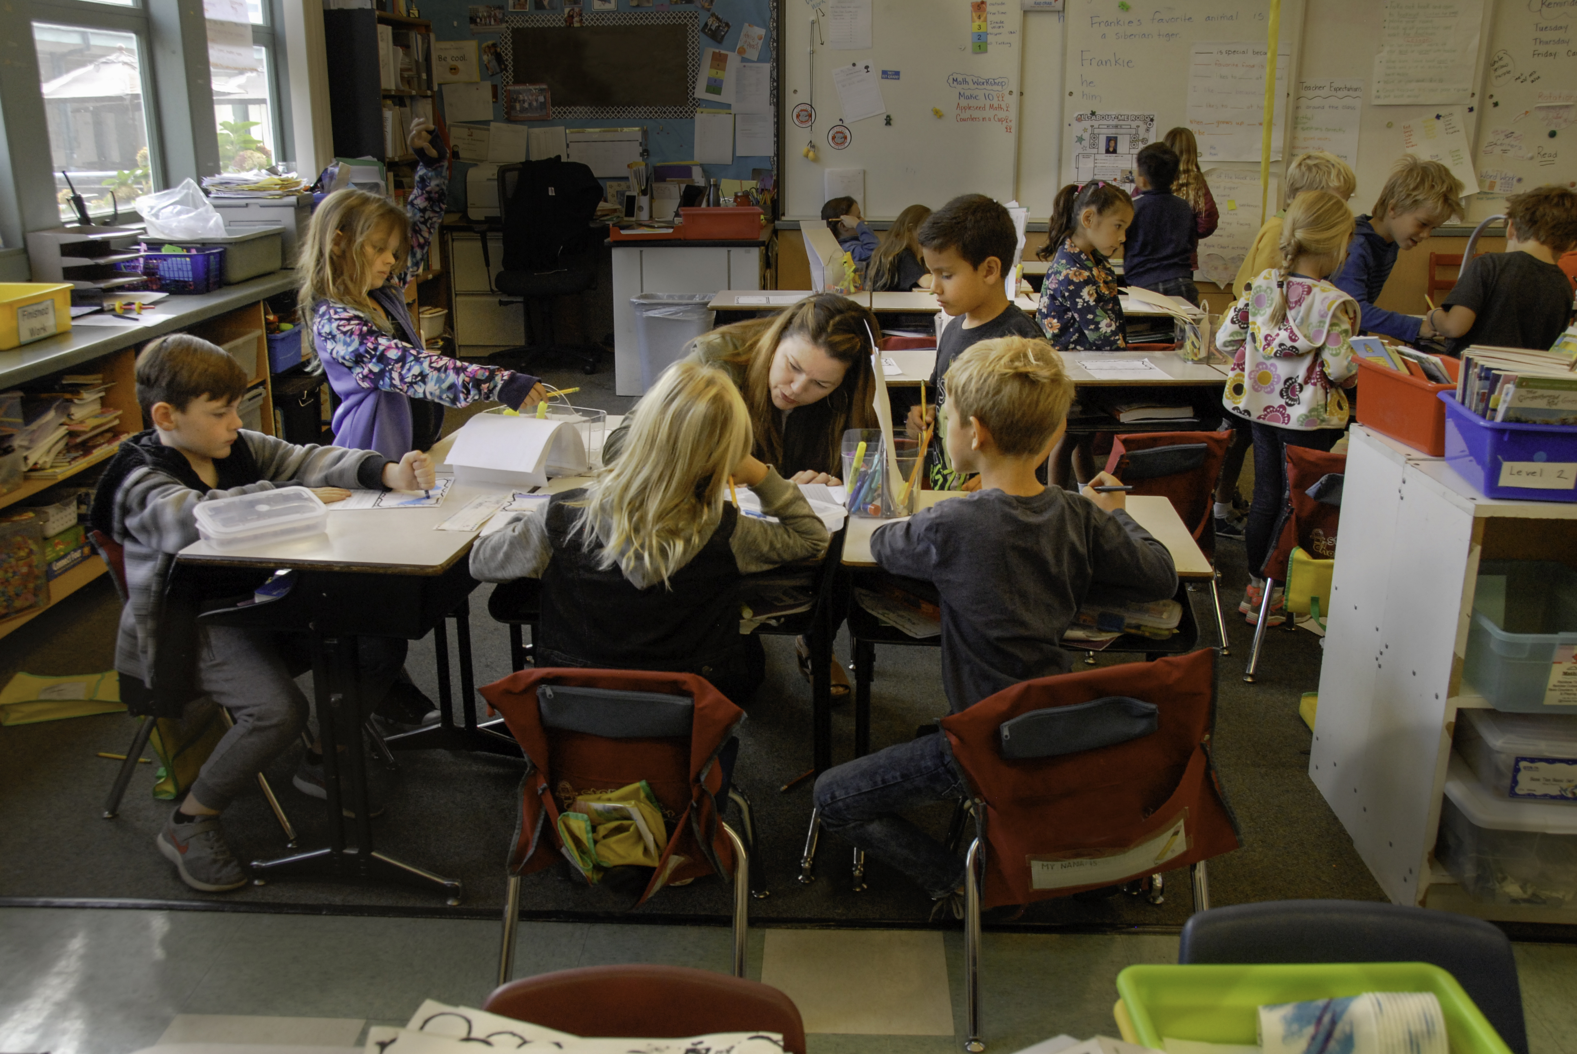
It’s all for the children!

